Slide 1
SWBAT understand why we study rocks and what information we can tell from them

Slide 2

EARTH SCIENCE
https://www.youtube.com/watch?v=V2381lUhqc0

Slide 3
Geology
Geology is the study of the Earth; how it works and its history

Slide 4
SWBAT understand why we study rocks and what information we can tell from them
Some things we are able to tell by studying geology:
History of Earth
History of Life on Earth
Climate Change
Resources and minerals
Natural disasters- earthquakes, landslides, floods and volcanic eruptions

Slide 5
SWBAT understand why we study rocks and what information we can tell from them
History of the Earth
Can anyone guess how old the Earth is?
4.53 billion years old
Notes:
Note on the board the guesses

Slide 6
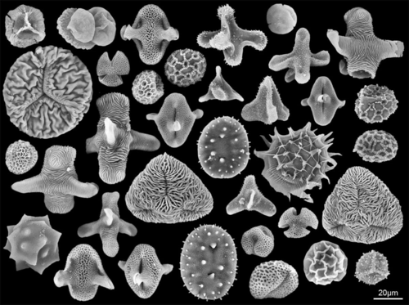
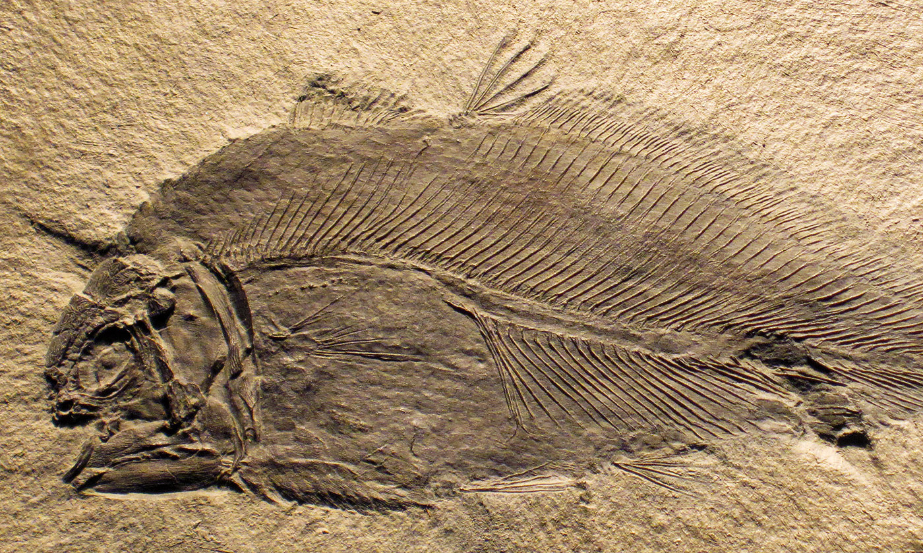
SWBAT understand why we study rocks and what information we can tell from them
History of life on Earth
Pollen trapped in rocks
Fossils

Slide 7
SWBAT understand why we study rocks and what information we can tell from them
Climate change
Why do you think we are able to tell climate changes from rocks?

Slide 8
SWBAT understand why we study rocks and what information we can tell from them
The geological record of ancient climate is excellent.
Ancient temperatures can be determined very precisely, because the composition of the shells of corals and other marine organisms varies measurably with it.
Furthermore, the plants and animals that lived during a given time and are now preserved as fossils indicate whether the climate was wet or dry.

Slide 9
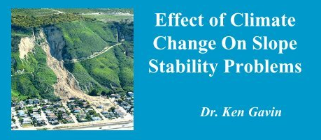
SWBAT understand why we study rocks and what information we can tell from them
The study of geology will also assist us in determining the impacts of the coming climate changes and its effects on
the land we live on
the land we grow food on
the waters/rivers/irrigation we rely on
the natural disasters that will endanger our lives and livelihoods

Slide 10
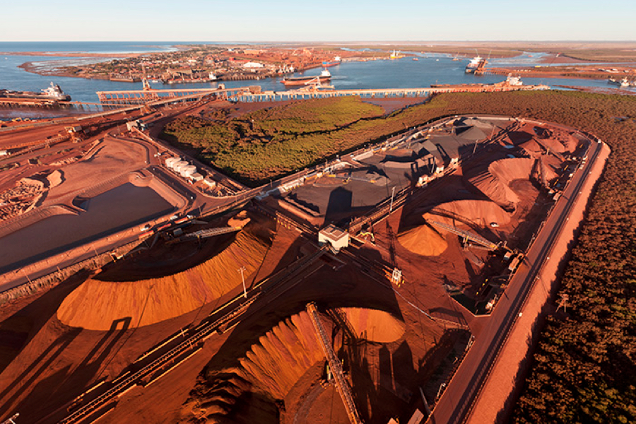
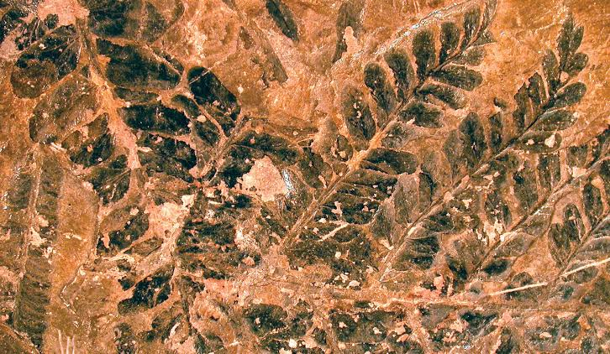
SWBAT understand why we study rocks and what information we can tell from them
Climate change
Salt layer preserved due to fast evaporation (hot climate)
As glaciers melt they leave till which indicates past freezing
Rocks in hot desert environments often red colour with iron deposits
Fossils of plants and animals

Slide 11
SWBAT understand why we study rocks and what information we can tell from them
Resources and Minerals
Can you think of resources and mineral that we mine?
Notes:
Do a brainstorm on board of all the minerals and resources that we mine

Slide 12
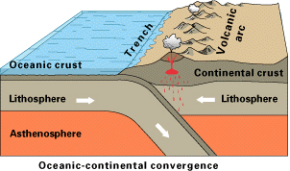
SWBAT understand why we study rocks and what information we can tell from them
The study of rocks can provide information about Natural Hazards
Such as:
Earthquakes
Landslides
Volcanoes
Flooding
Notes:
Ask the class why it would be important to know more about natural hazards

Slide 13
SWBAT understand why we study rocks and what information we can tell from them
This Unit:
Different types of rocks: Igneous, metamorphic and sedimentary
Volcanoes creating rocks
Mining

Slide 14
SWBAT understand why we study rocks and what information we can tell from them
Worksheet
Why Geology worksheet

Slide 15
SWBAT understand why we study rocks and what information we can tell from them

